Slide 1




Detect Musical Key
Nancy LU,
Nov 23
EE 5438 | Final Presentation
Notes:
Hi everyone, good evening my name is Nancy LU, Tonight I will give a presentation about detecting musical key. And let's start!

Slide 2
01
04
Motivation & Problem
Results
02
05
Music to Technology
References
03
06
Experiment
Wrap Up
Notes:
I will start with the motivation for the project. Then I will discuss about my experiment and results before wrapping up

Slide 3
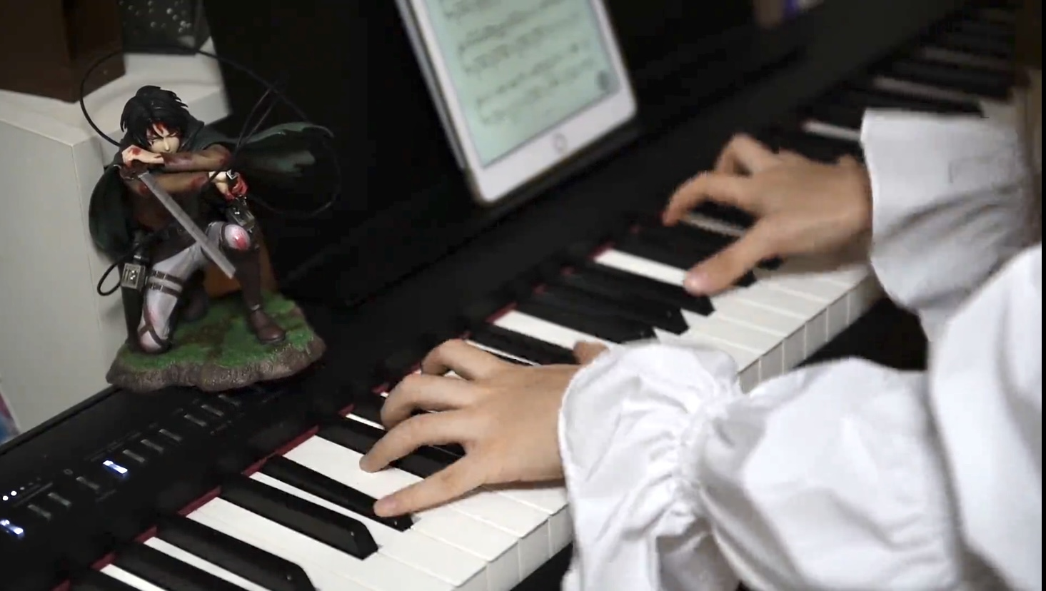
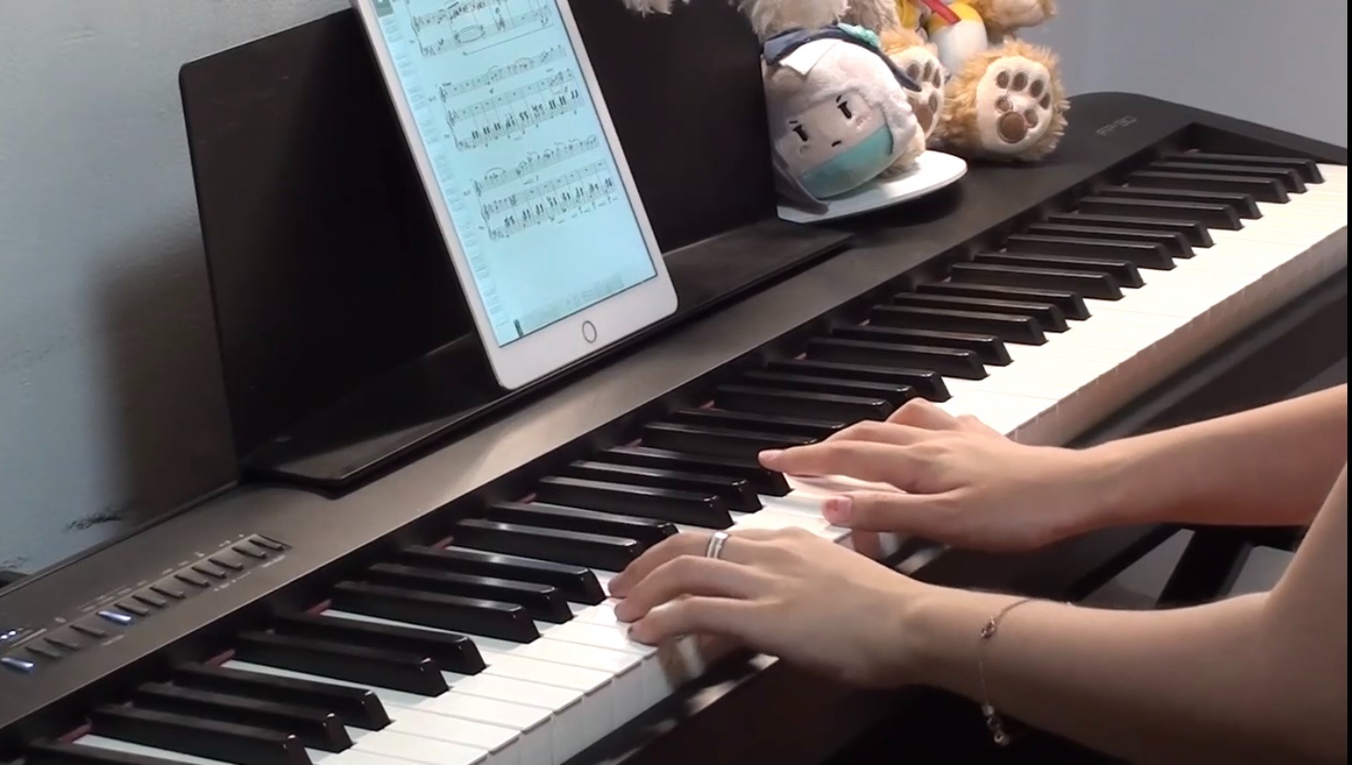
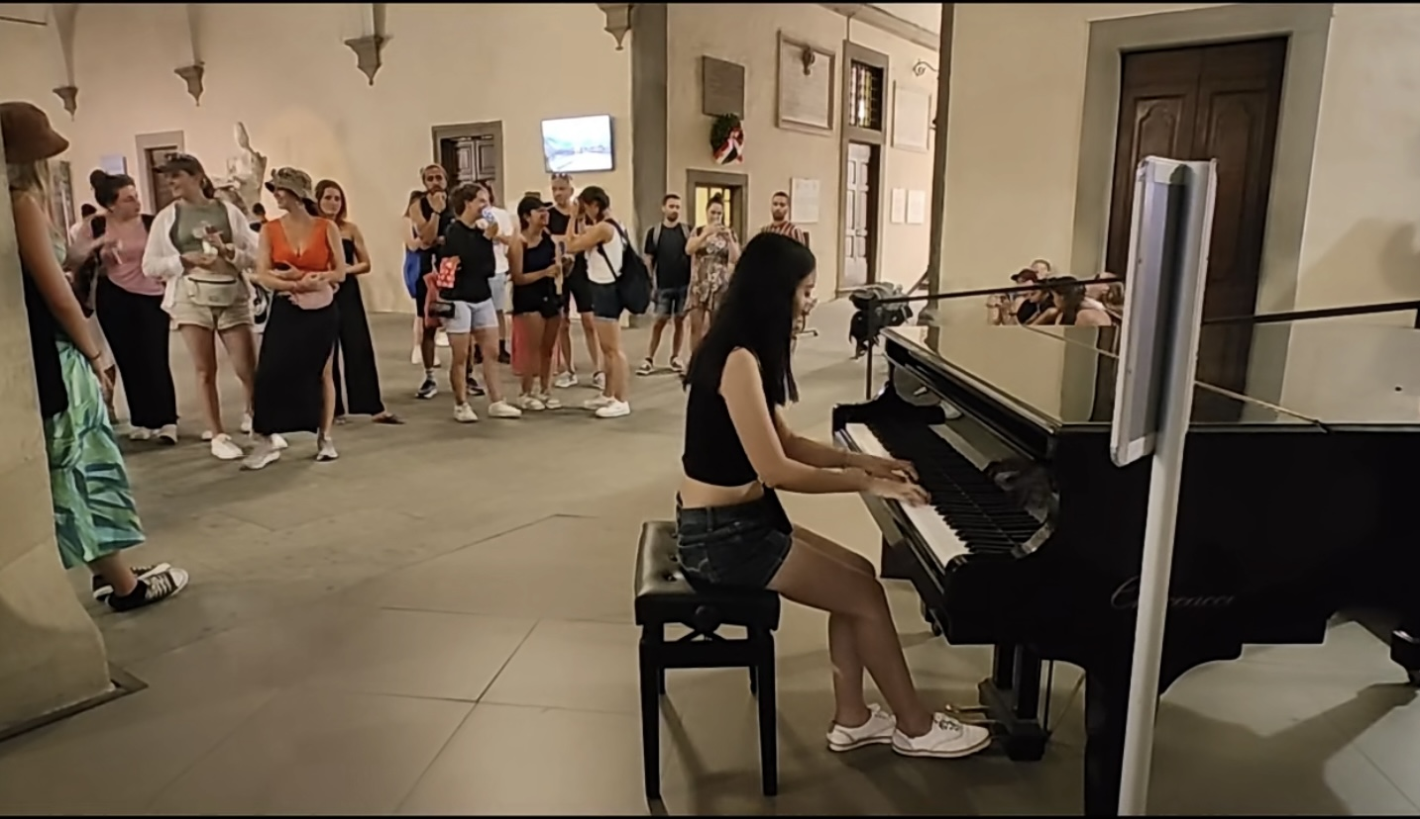
Motivation
About me
As a piano lover, I always enjoy creating piano covers of newly released songs.
The first step of composing is to ensure that the musical key of the original song matches the key I will be playing on the piano, which is a very complex task for individuals without background in music.
心臓を捧げよ
進撃の巨人
人生のメリーゴーランド
ハウルの動く城
Part of Your World
The Little Mermaid
Notes:
The motivation is from that I am a piano lover, and I always enjoy creating piano covers of newly released songs. You can see the pictures in slides left, I played a lot of types music from animation, disney movies and TV series. But you know compose a piano cover is not easy, the .......
Therefore, lets talk about why this is a complex task

Slide 4
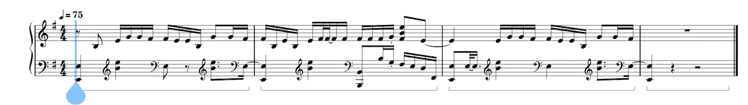

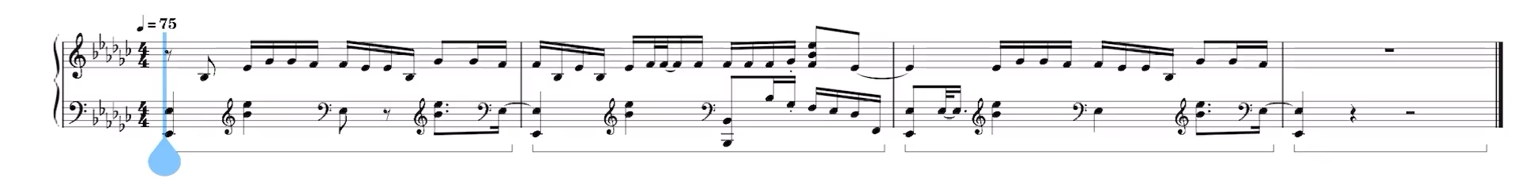
Problem
Why this is a complex but interesting task?
E minor
GODS
﻿League of Legends
2023
Eb minor
Notes:
And I will give you a very interesting test to answer this question. Here is a very popular song I think most of you must heard of it, which is from league of legends 2023 called GODS. And I wrote down this melody in two different musical key, try to choose which one is matched with the original song. You can see the two pictures are totally same except the red square, and the red square is denoted as musical key. So let's listen!
Do you have any ideas? I think most of you can't listen to the difference, However, machine learning will help us do that!

Slide 5
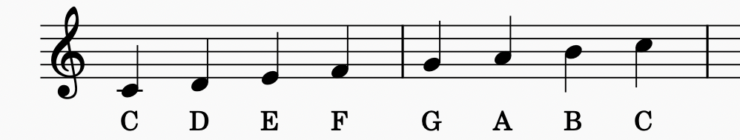
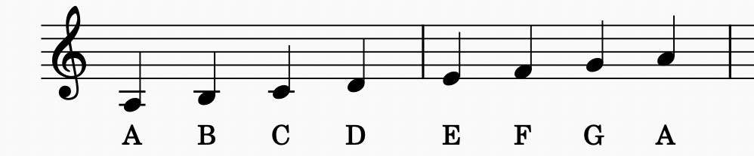
Problem
What is musical key?
More simple way:
In technology: different frequency (Hz)
In music: different tonic note and mode
In this project:
Musical key = tonic note + mode
tonic note: C, Db, D, Eb, E, F,
F#, G, Ab, A, Bb, or B
Mode: minor or major
C major
A minor
the C major and A minor scales, contain the same notes, but actually represent different keys due to the different tonic notes and corresponding chords.
Types of musical key is
12 (tonic notes)× 2(modes) = 24(types)
Notes:
This “key” is based upon a chosen underlying scale from which fundamental relationships between certain notes give rise to sets of intervals and chords that quite simply sound good together.
specially notice that .......
What you should know is that the types of musical key is 24.
Let's start our experiment.

Slide 6
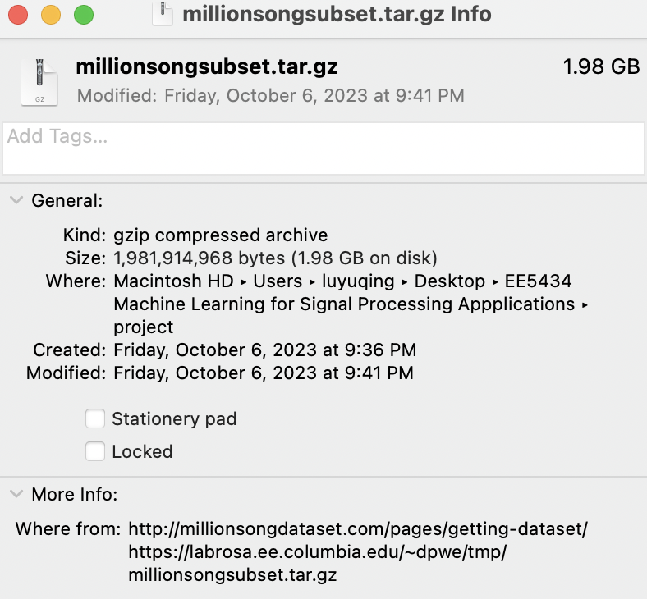
Experiment
Dataset
Million Song Dataset subset
a massive collection of features and meta- data for one million songs, provided by The Echo Nest. Due to the large size of the entire dataset (>300GB), this project was only able to use a 10,000 song subset.
http://millionsongdataset.com/pages/getting-dataset/
Notes:
The dataset I used is million song dataset subsest, you can download in this link in this slides. It is about 2 gb, which is not very big lol.

Slide 7
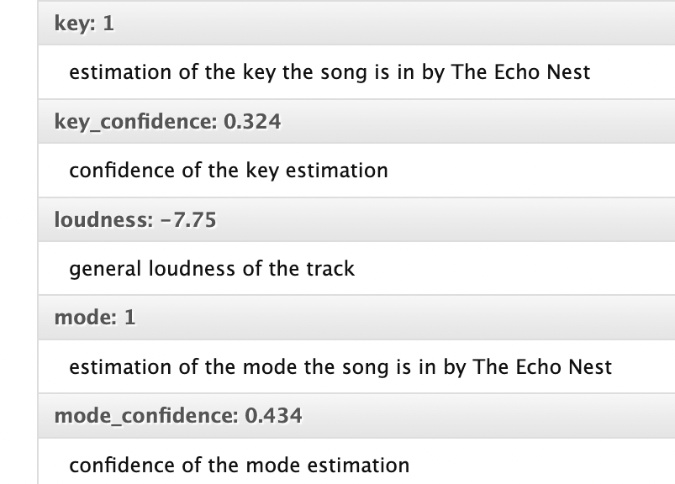
Experiment
Valid Data
Valid Data
Considered of two parameters of ’key_confidence’ and ’mode_confidence’ in dataset.
I designed a threshold of 0.5 to filter the subset. Therefore, the training data is limited to 3729 songs.
Notes:
and there are two parameters we should notice which means the dataset is not groud truth in somehow

Slide 8
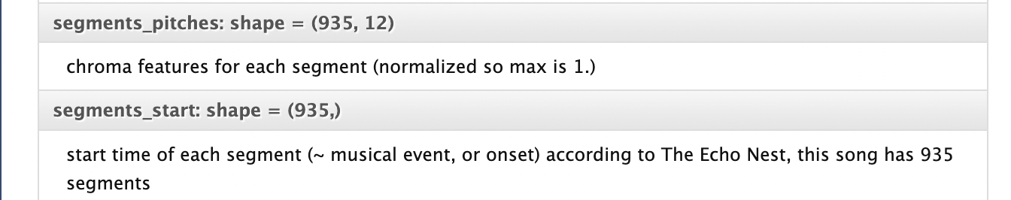
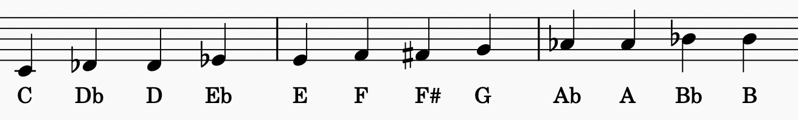
Experiment
Extract Feature
Pitch chroma
refers to a representation of the relative strength of each pitch class present at each time window in a song.
Notes:
The feature extraction I used is called pitch chroma..
the segments means time window,
and pitches includes 12 types just like the picture shown

Slide 9
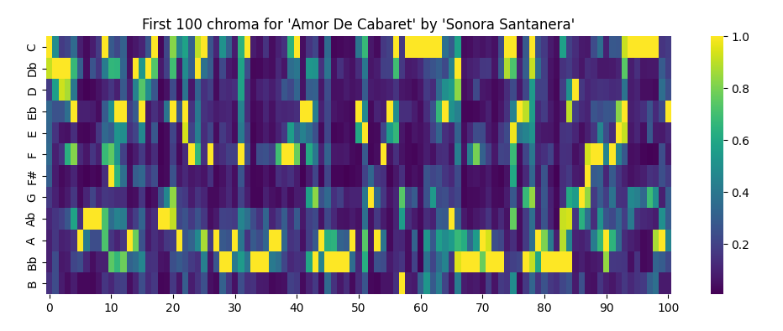
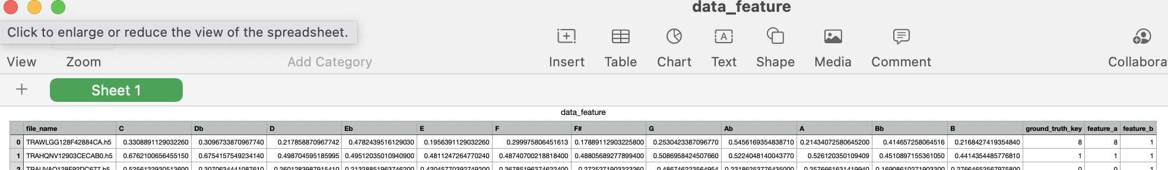
Experiment
Extract Feature
The lighter grids correspond to larger possible pitch values.
Finally, I average the chroma vectors given throughout the length of the song as the extracted feature.
a vector with length of 12 for one song.
Notes:
I visilize the parameter ’segments_pitches’ in dataset of First 100 chroma features generated from the input song.

Slide 10
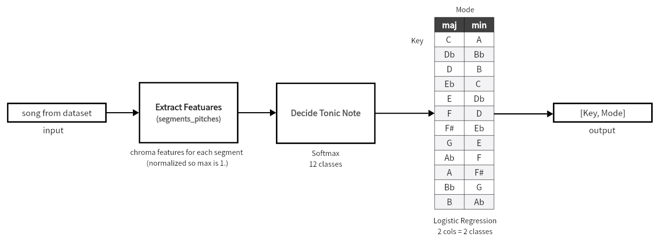
Technical Approach Summary
There are 13 models in this process
Model×1
Model×12
For each tonic note, train a model to decide mode.
Notes:
And this is my model pipeline to this project, you can see we build the first model to decide the tonic note which is 12 classes by using softmax. and then for each tonic note, I trained a model to decide mode of two classes by using logistic regression still a softmax for two classes.
Finally we got 13 models in this process

Slide 11
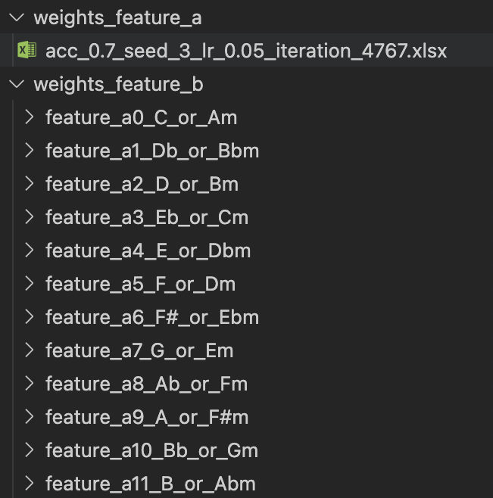
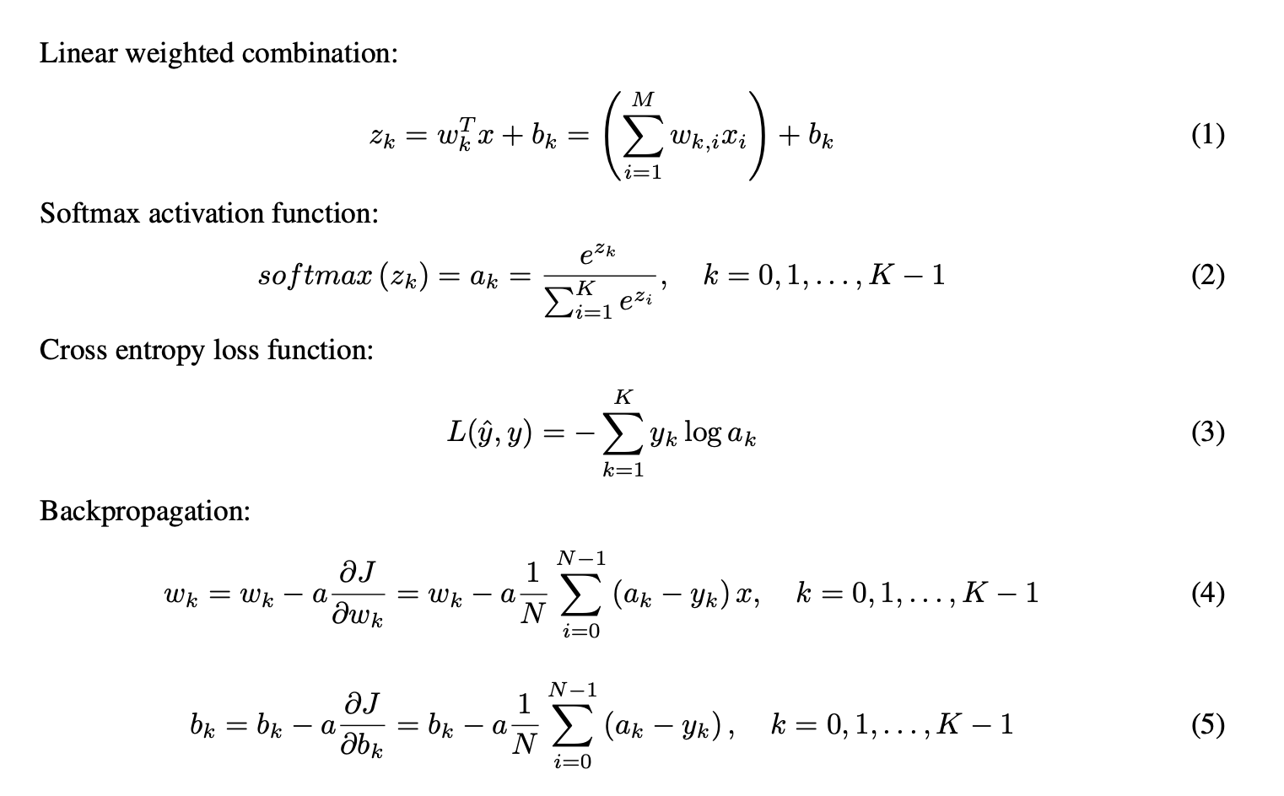
Experiment
Weights
12 + 1 models
Mathematical formula
Notes:
the picture left is the 13 weights I gained from training and the mathematical formula is I used in this project

Slide 12
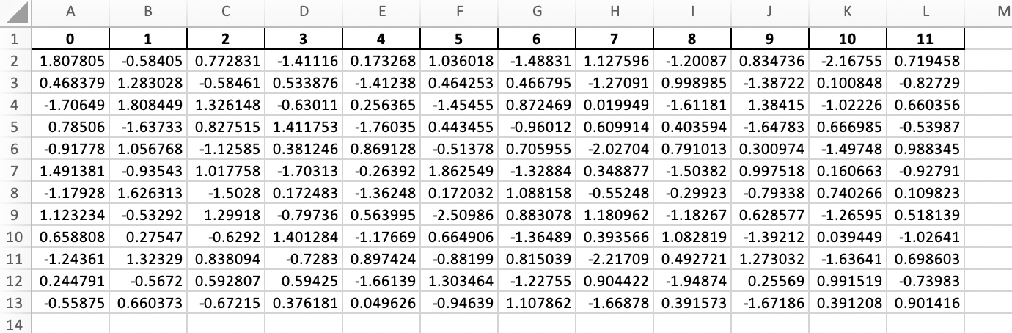
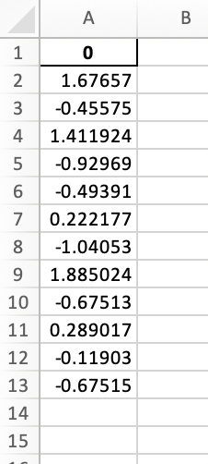
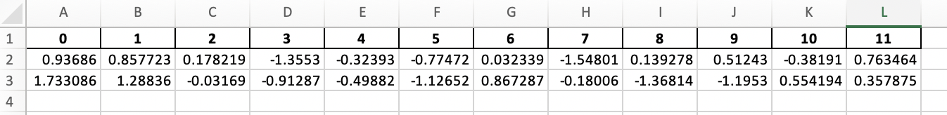
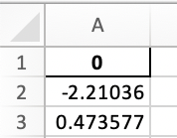
Result
Weights
The first model weights
To decide tonic note
Weights 12 × 12
Bias 12 × 1
C/Am model weights
From other 12 models weights
To decide mode
Weights 2 × 12
Bias 2 × 1
Notes:
And this is the best weights example I gained, including weights and bias

Slide 13
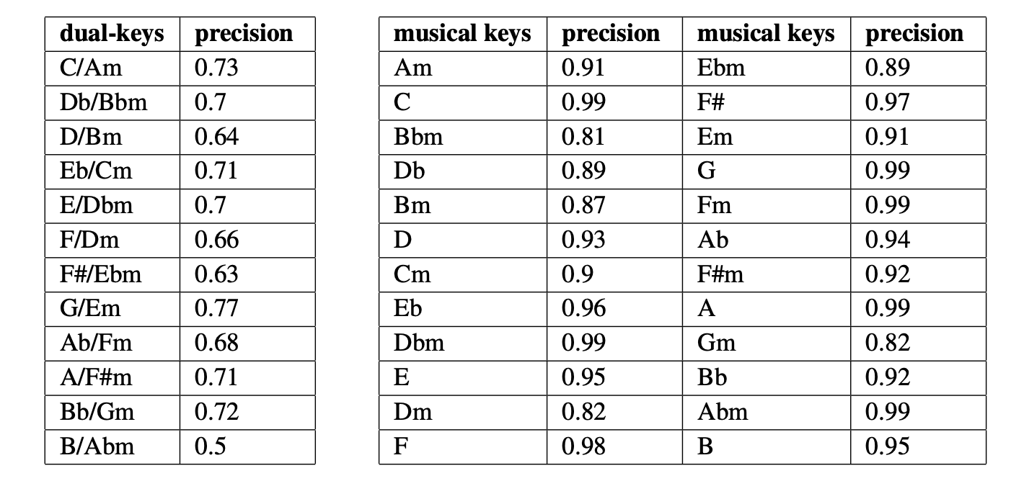
Result
Training result
C/Am model precision
From other 12 models weights
To decide mode
The first model precision
To decide tonic note
Notes:
And this is the precision I got from the validation dataset.

Slide 14
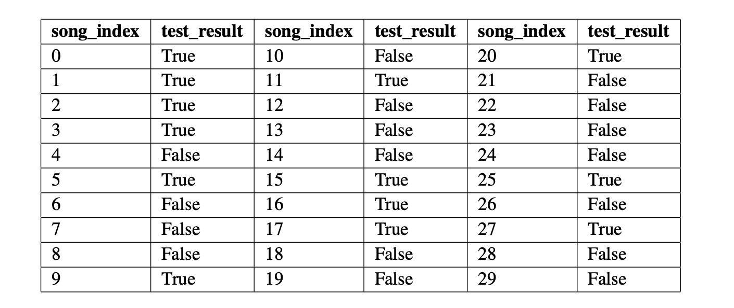
Result
Testing result
Randomly selected 30 songs from the remaining portion of the Million Song Dataset. However, the ’key_conf’ and ’mode_conf’ values for these songs were not higher than 0.5.
Notes:
Then I randomly selected 30 songs as test data. But considered of we are lack of data, those confidence of data are not satisfied our threshold 0.5

Slide 15
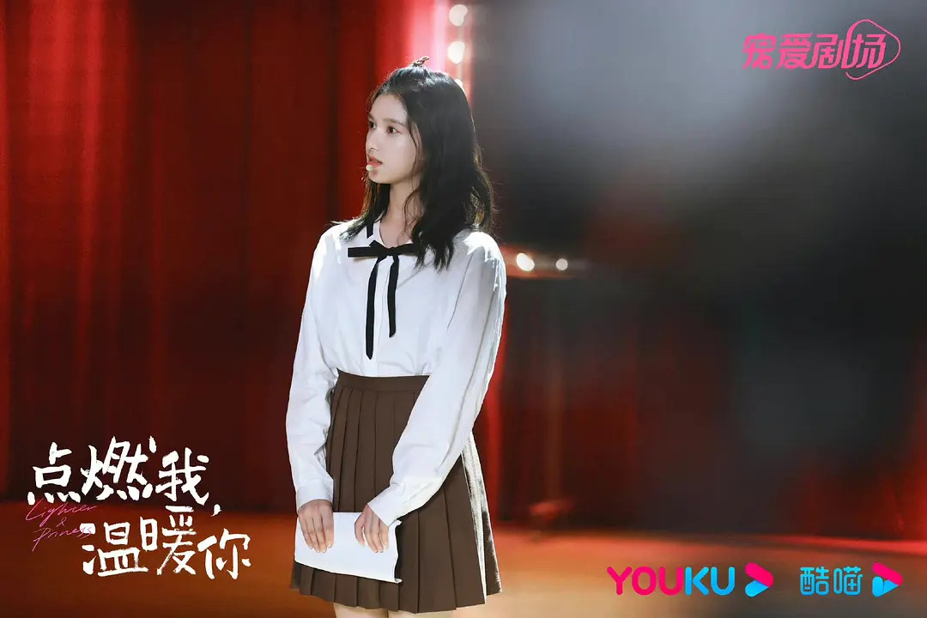
Result
In practice
How to use the model to address practical problem?
To be more challengeable, I choose a non-mainstream music, which means there is no piano cover in the whole website. I am the first fans to compose this piano cover.
What I want to do is to use the model we generated to detect musical key and help me to compose this song in piano sheet.
Qinghong
﻿Lighter and Princess
2022
Notes:
But I still want to do another very interesting test here to use my model to address practical problem. This song called qinghong from a tv series called lighter and princess where my favorite actor zhangjingyi took part in.

Slide 16
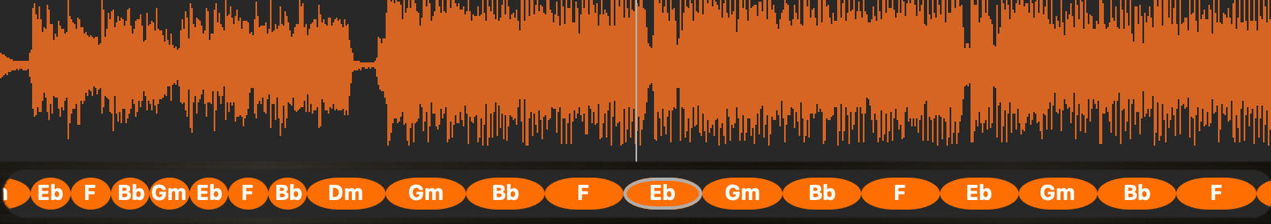
Result
In practice
Get the average chroma vector 1 × 12
If you are familiar with chords like me, it will be a very easy task.
But if you are not, you can use other technique to get the chord sequence.
I used the most simple major 3 or minor 3 chords to write the pitches in chord
Notes:
The first thing is to prepare dataset,
the picture is an example to get chord sequence.

Slide 17
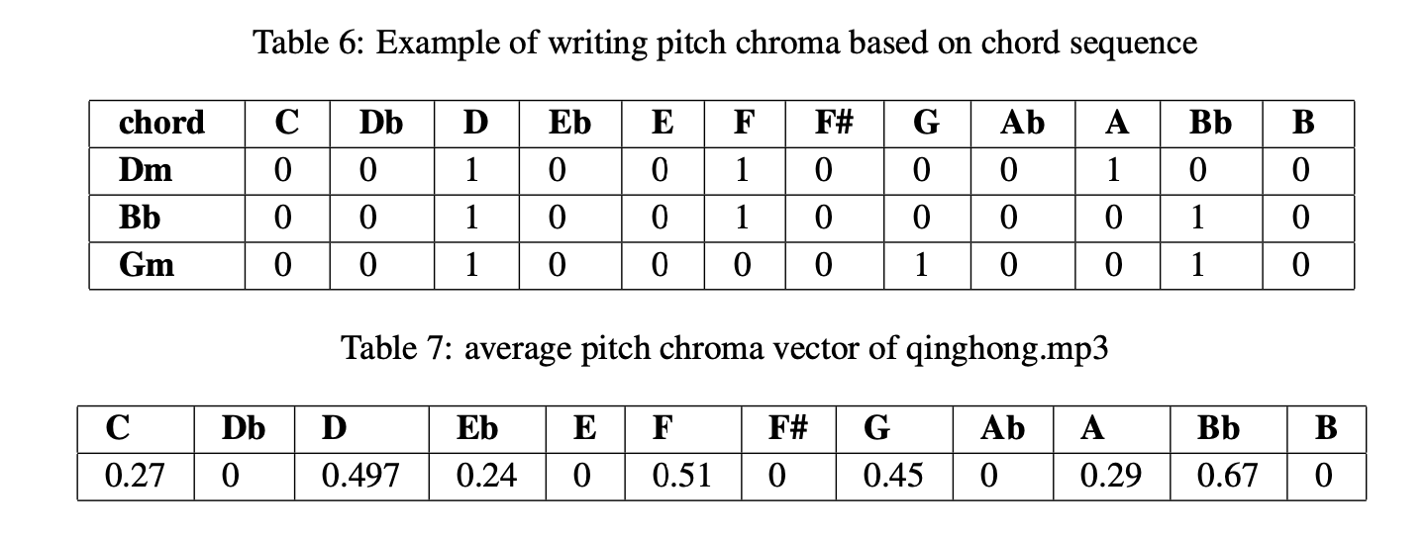
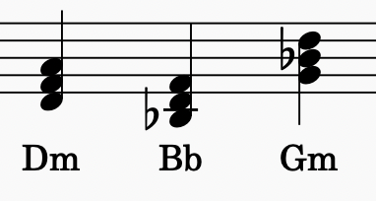
Result
In practice
Get the average chroma vector 1 × 12
I used the most simple major 3 or minor 3 chords to write the pitches in chord
Notes:
I used the most simple ....
you can see the example of chord D minor, which consists of D, F, and A, and I will give the value of 1 in this three pitches, others will be given 0=zero. Then iteration this step, finally we average the total pitch chroma, we get a 1*12 vector and lets see the result!!!!

Slide 18
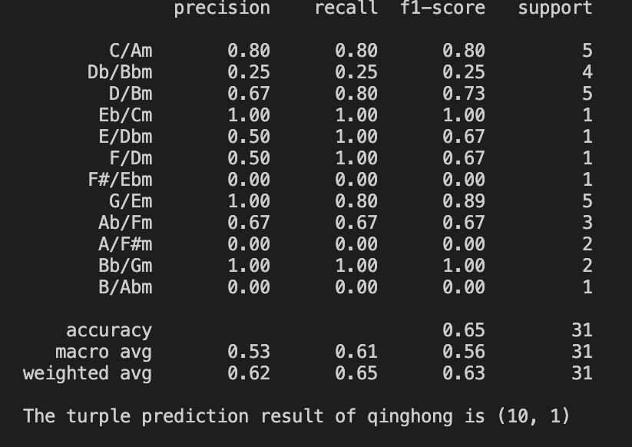
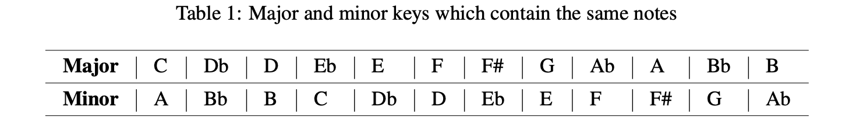
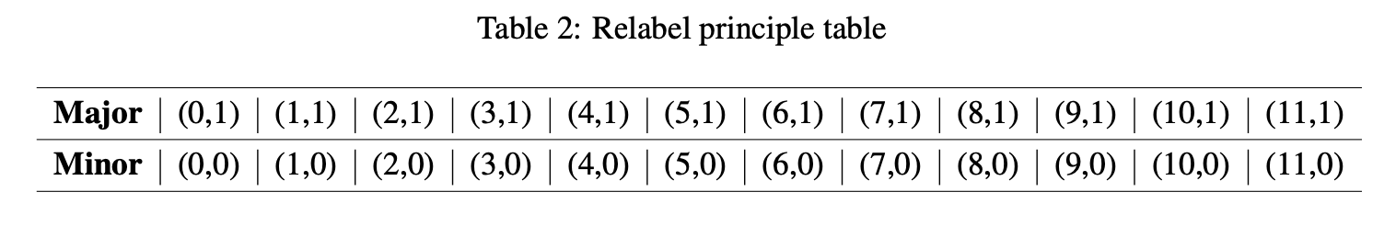
Result
In practice
The musical key of qinghong is Bb major!!
Notes:
the turple we got is 10 and 1, is that correct?! lets see

Slide 19
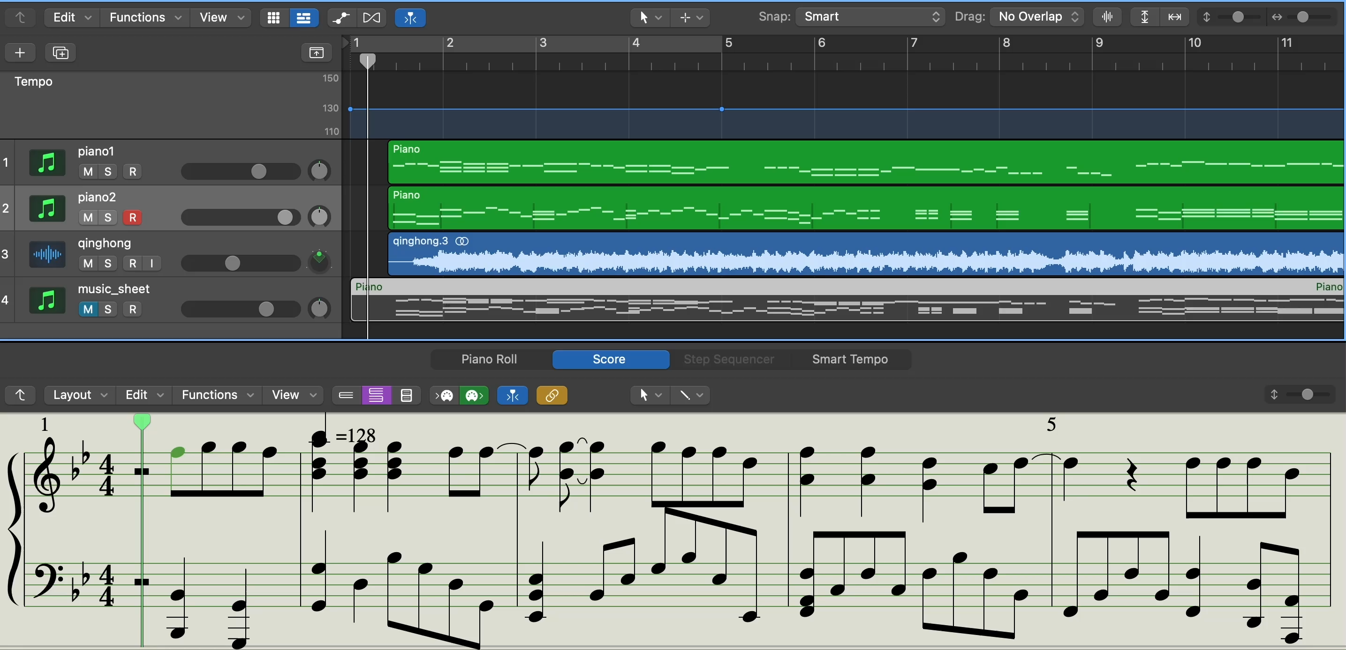
Result
In practice
Added
Piano
track
Musical
Key of Bb
Notes:
I added the piano track I writed in musical key Bb( B flat) to the original song track. Let us listen it and it is quite harmony which means our detection is correct. It's inspiring and our model worked!

Slide 20
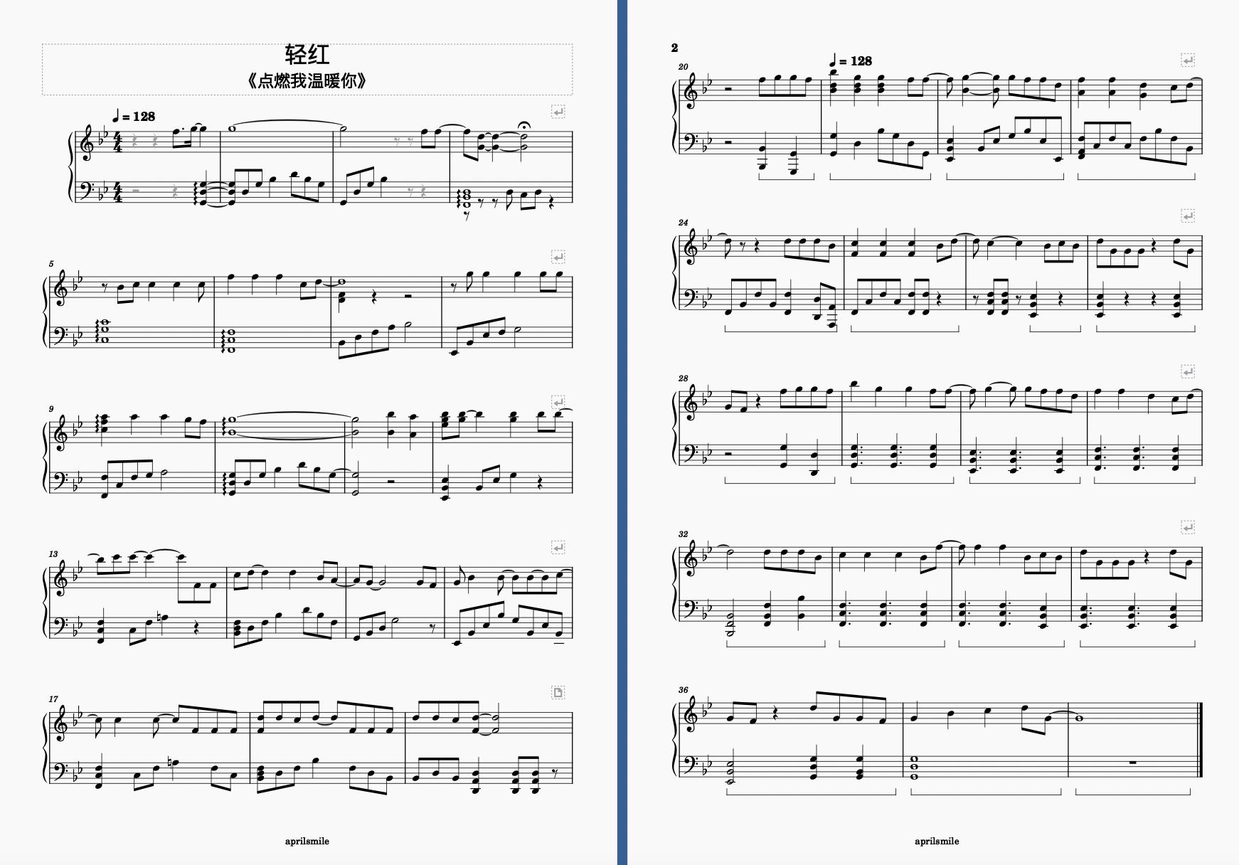
Result
In practice
Qinghong-Bb major
Piano sheet
Copyright: © 2023 aprilsmile1
Notes:
the turple we got is 10 and 1, is that correct?! lets see

Slide 21
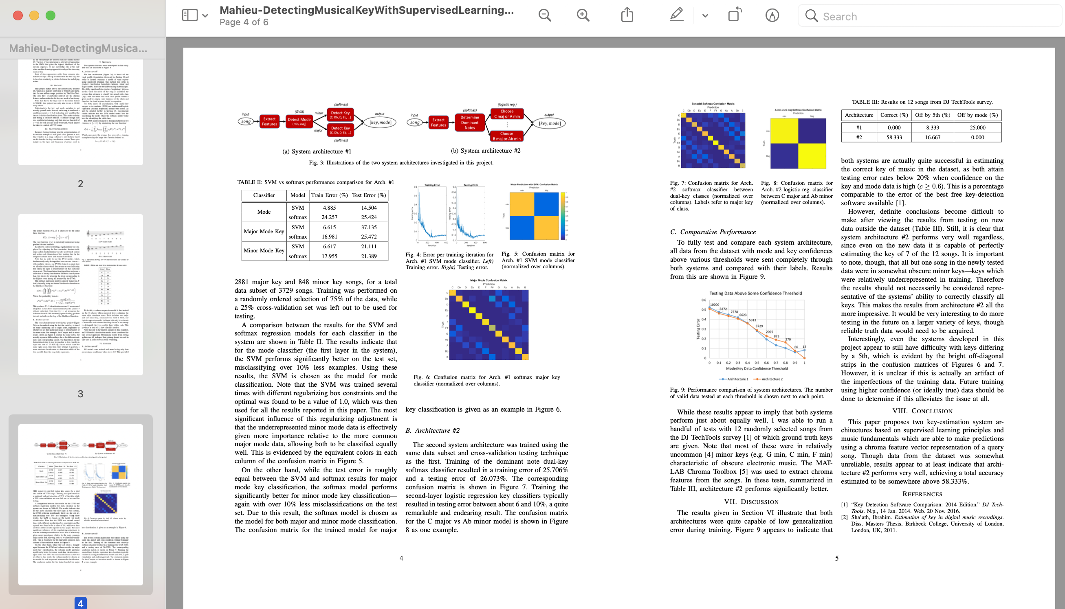
References
Resources
Source codes have uploaded:
https://github.com/Aprilsmile1/detect-musical-key.git
Acknowledgement/project idea from
https://cs229.stanford.edu/proj2016/report/Mahieu-DetectingMusicalKeyWithSupervisedLearning-report.pdf
Notes:
And all the document of this project have uploaded in github, and the idea refers to a report from Stanford university in 2016.

Slide 22
THANKS!
Do you have any questions?
Notes:
And this is all the content of my presentation, thank you so much for your time to listen. If you have any questions just feel free to ask.

